Slide 1
CoST LatinAmerica
Better value from infrastructure
Bernadine Fernz, @CoSTransparency
XII Annual Conference on Government Procurement 2016

Slide 2
What is the context?
Global construction likely to be worth $15 trillion by 2025
Estimated that 10-30% lost through corruption
Potential savings of $5 trillion
In Latin America, $1.5 trillion expected over next decade (IADB 2014)
Infrastructure spending gap = Actual Spend (UNEC)
Almost ALL Latin American countries rank in the bottom half of CPI
Notes:
Provide some context.
“Infrastructure matters”
Infrastructure directly or indirectly affects people’s lives and is vital for growth, productivity and achieving development goals such as poverty reduction, improved health and lower mortality rates, access to education, markets etc.
What is happening globally and in LatAm?
Global construction likely to grow by almost 100% from $7.2 trillion in 2010 to $15 trillion by 2025
Estimates of losses through corruption range between 10 - 30 %
This means the potential savings through reducing corruption, mismanagement and inefficiency could be upwards of $5 trillion annually.
In Latin America, $1.5 trillion in infrastructure investment is expected over the next decade (IDB2014).
Source: http://www.iadb.org/en/news/news-releases/2014-09-03/infrastructure-opportunities-in-latin-america,10897.html
In Panama, $20bn by 2016, another $20bn by 2019 (that means $40 billion will be invested by 2019).
In Panama, US5.5bn has already been invested in the Canal expansion. In January 2016, the Panama Canal Authority stipulated that more than USD 800 million will be invested (to meet increased canal demand) from the final months of 2016 (http://www.focus-economics.com/countries/panama)
CPI
Almost ALL Latin American countries rank in the bottom half of CPI
- Only countries in the top half are: Chile, Uruguay, Costa Rica, Cuba, Brazil, Panama are in the top half
Central American Countries are some of the worst performers

Slide 3
What is CoST?
CoST is an Infrastructure Transparency Initiative
MULTI-STAKEHOLDER: Stakeholders working together to tackle a common challenge
DISCLOSURE: Publication of key project and contract data into public domain
ASSURANCE: Independent review of disclosed data highlighting issues in plain language
Disclosure + Assurance = Empowered citizens
Notes:
Multi-stakeholder working brings together the different actors around a common challenge, improving the value, efficiency and effectiveness from public infrastructure.
The MSG is responsible for providing leadership and setting policy and standards for the CoST programme.
The MSG:
Enables country ownership and leadership, setting standards for the national programme
Offers a shared and neutral space for dialogue
Provides legitimacy, building trust and social capital

Slide 4
How does CoST work?
Start: Corruption, inefficiency and mismanagement
Better value for money and better quality infrastructure
Informed citizens and responsive public institutions work together
Multi-stakeholder initiative, promoting disclosure
End: Increased quality of life for citizens
Notes:
A multi-stakeholder initiative to promote the disclosure of information on public investment in infrastructure. This helps to inform and empower citizens and enables them to hold decision-makers to account
Informed citizens and responsive public institutions combine to reduce mismanagement and inefficiency and create a business environment in which corruption is less likely to occur
Ultimate impact of these changes is better value for money and better quality infrastructure and services.

Slide 5
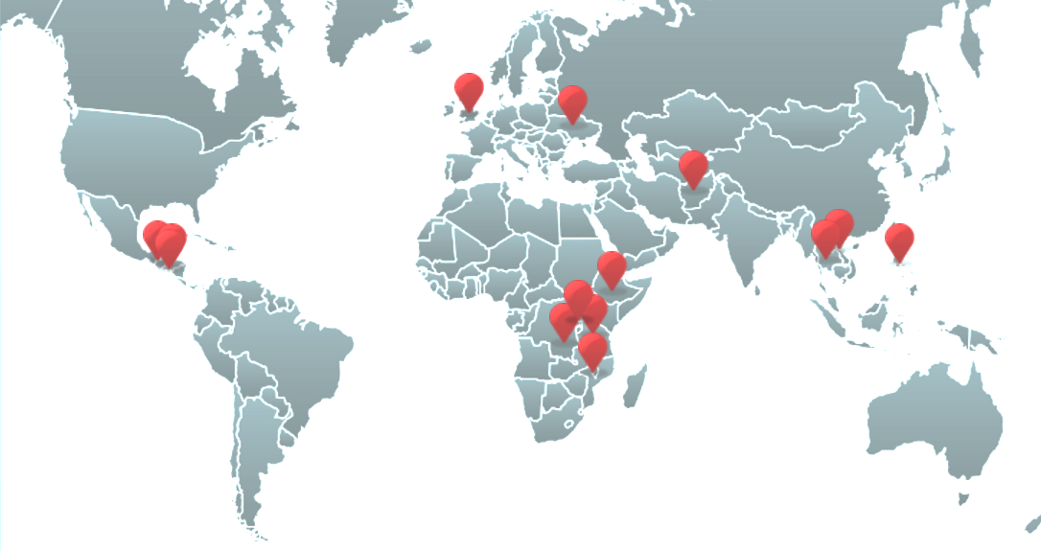
CoST, growing worldwide
Nationally, CoST is locally led and managed
Internationally, CoST provides guidance
@CoSTransparency
Notes:
Based on the lessons of the three year pilot with 8 countries from 2008-2011, CoST launched in October 2012 and now has 15 member countries:
From pilot – Ethiopia, Guatemala, Malawi, Philippines, Tanzania, United Kingdom, Vietnam & Zambia
Since 2012 – Afghanistan, Botswana, El Salvador, Honduras, Thailand, Uganda & Ukraine
Additional governments have registered their interest and commenced the application process.
At the international level, CoST provides a set of principles and guidance on increasing transparency and accountability in public infrastructure. It supports country operations through guidance, technical support and the exchange of knowledge and experience.
At the country level, the operation of CoST reflects local conditions and preferences. National programmes are locally led and managed, adapting and applying the core features according to the local legal, institutional and sector environment.

Slide 6
Emerging Trends
CoST Country profiles in Latin America are changing
Motivations are changing. Shift away from “corruption”.
Growing emphasis on
“better value”, “efficiency gains”, “performance improvements”
“building credibility”, “participatory governance”, “citizen engagement”
Mature CoST Countries are going ‘beyond transparency’
Notes:
What are some emerging trends/lessons?
CoST Country profiles are changing – upward trend in the income levels/economy of new countries
Chile is OECD. Costa Rica is on the OECD ascension track.
United Nations’ Economic Commission for Latin America and the Caribbean (UNEC) recent study:
Infrastructure spending gap = actual spend (UNEC)
- This means that spending would have to be doubled in order to satisfy the demand for infrastructure
- So there is a need to do things more efficiently; Countries are increasingly aware that they must maximise the efficiency of scarce resources to meet increasing demand. They need better value for money.
Next step SEA PF. Thailand/Malaysia/Indonesia/Vietnam. Should I add a slide to show their economic status? And/or importance to CoST/region?

Slide 7
CoST Transparency
Disclosure Requirements
Notes:
Pre-CoST compliance % – show % compliance with pre-CoST data points
CoST compliance % - show % compliance of an increased # of data points. If only pre-CoST data points were measured, compliance rate is likely to increase.
Also for countries disclosing CoST IDS+, the % compliance will also increase if only IDS data points measured.

Slide 8
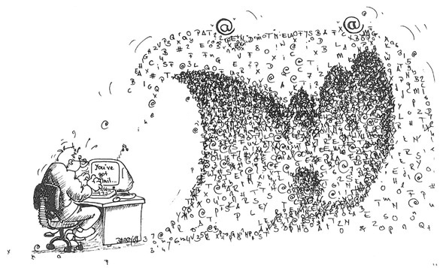
CoST Transparency: More than just ‘data’
Main challenges affecting disclosure:
Accessibility: not retrievable/too complex
Technology: inadequate systems
Resources: lack of finances/personnel
Data capture: data not collected/stored
Country | Online Platform
Costa Rica | MapaInversiones
Ethiopia | PPPAA site
Guatemala | Guatecompras
Honduras | SISOCS
Philippines | PhilGEPS
CoST consolidates data and technology by linking different/multiple platforms
CoST interprets and presents data in simple language that is easy to understand
CoST enhances disclosure capacity and technology through bespoke disclosure platforms
Notes:
What is good data?
Accurate
Complete
Relevant
Timely
Reliable (and comparable. Using stable and consistent data collection methods means you can track real changes/progress on projects instead of variations in data collection methods)
Valid (should measure what it is intended to measure)
Needs Analysis :
Main challenges affecting disclosure:
(in order of priority)
Accessibility: data is captured but not easily retrieved
Technology: inadequate systems for disclosure
Resources: Lack of finances/personnel to disclose
Data capture: data is not being collected or stored
Scale: 3,000+ projects from 800+ PEs disclosed on Guatecompras
145+ projects disclosed on SISOCS (since Dec 2014)
Capacity Building
Government
>250 government
officials trained in 12 months
Citizens
>500 citizens trained in 12 months
>100 MoUs signed with grassroots organisations/citizen commissions

Slide 9
CoST Transparency: Access for All People
Countries | Internet Penetration (%)
Chile | 67.3
Colombia | 61.6
Costa Rica | 84.7
El Salvador | 28.5
Guatemala | 19.7
Honduras | 18.6
Mexico | 49.2
Panama | 52.7
Peru | 41.7
CoST Ethiopia Case Study
Developed mixed media strategy to increase citizen access to information.
Tailored communication channels based on regional and local context e.g. community meetings in rural areas
Source: Internet World Stats www.internetworldstats.com
Notes:
Internet penetration rate: percentage of the total population that uses the Internet
CoST Honduras is working with 175 municipal Citizen Transparency Commissions to support communities in using this information to demand accountability

Slide 10
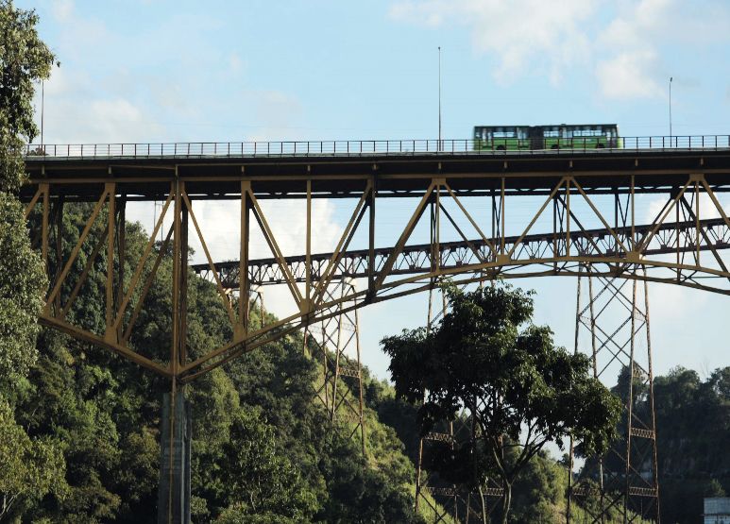
Beyond Transparency: Project Impacts Guatemala Belize Bridge
CoST Guatemala Assurance Team discovered:
Contract to Rehabilitate the Belize Bridge was awarded under emergency procedures
BUT there was no ‘emergency’
Works were not needed
BUT if carried out, the bridge would have been damaged, requiring further repair
MSG highlighted issues and the contract was annulled
CoST Guatemala intervention saved US$5 million.

Slide 11
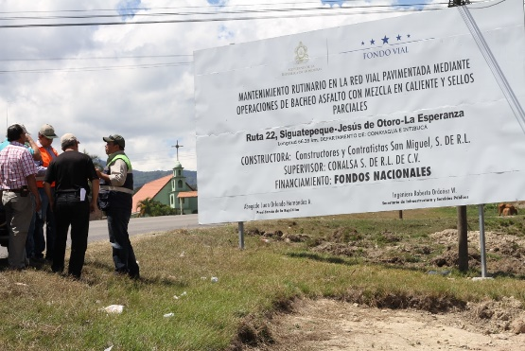
Beyond Transparency: Project Impacts Honduras Route 22 (Siguatepeque-Jesus de Otoro-La Esperanza)
CoST Honduras Assurance Team discovered:
Contractors in violation of environmental regulations & standards
Asphalt heated/burnt in open barrels/drums on the roadside
Toxic chemicals and pollutants released into the atmosphere
Harmful effects to local community e.g. respiratory illness/skin cancer
Also dangerous for workers; risk of severe burns and combustion
CoST Honduras alerted supervision company who took immediate action
CoST stopped environmental violations
working with government and civil society to improve environmental compliance
Notes:
Note: Fondo Vial environmental disaster example?? Ruta 22 (Siguatepeque-Jesus de Otoro-La Esperanza)
Basically they were heating the asphalt onsite, and the methods used were primitive causing significant emission of fumes.
What is Asphalt?
Asphalt is used for paving roads, parking lots and roofing. It consists of gravel, sand, and stone that is bound together by a cement-like substance derived from crude oil. The ingredients used to make asphalt are mixed under high temperatures and kept heated until the asphalt is applied to a surface. Asphalt fumes are generated during the heating of the mixture
Emissions of fumes from asphalt production (inc. Scarifying with open flames)
(Pavement and asphalt scarifying is the process of breaking up the surface of the pavement.)
http://asphalt.org/downloads/2008-Pavt-Environment-GJAK.pdf

Slide 12
Beyond Transparency: Broader Impacts Honduras Las Crucitas – Teupasenti Road Project
CoST Honduras Assurance Team discovered:
Project approved on inaccurate information. Community resettlement needs/plans not declared.
Social impact significant; work began before communities were informed/resettled
Time and cost overruns
> 7.5 year time delay (92 months)
> US$5 million cost escalation (approx. 120% increase)
CoST Honduras highlighted the issue. Ministry of Finance introduced new regulations including specific requirement to disclose resettlement needs and costs at project proposal stage.
CoST helped introduce stricter rules for project approvals
working with government to improve enforcement for false/incomplete information
Notes:
Provide some examples of impacts (beyond transparency)
How is CoST changing things on the ground?

Slide 13
Beyond Transparency: Broader Impacts
Procurement reforms:
Restrictions on NGOs in construction
Requirements for sufficient funds before tender
Efficiency gains
Better management and coordination on projects
projects > likely to be completed on time and within budget
CPI Ranking Improves: Honduras climbs 14 places
Notes:
Guatemala
Restrictions on NGOs Art. 33 Bis, Decree 101-97, Organic Budget Law
The 2nd and 3rd Assurance Reports (December 2011 and April 2013) highlighted that ‘fake’ NGOs were being awarded construction contracts – which they had no capacity to build/implement. (These NGOs were established as a means of by-passing procurement regulations to siphon off funding intended for public infrastructure projects).
As a result of the Assurance Reports, the MSG engaged in a series talks/negotiations with the Vice President’s Office – which resulted in the Vice President’s Office issuing a regulation prohibiting NGOs from wining construction contracts in 2013. Congress has now ratified the regulation which gives it even more strength.
The Guatemalan laws to prevent contracts from being awarded prior to funds being secured are:
1. Amendments to the Organic Budget Law- Decree 09-2014 Art. 1
2. Regulations of the Organic Budget Law- Government Agreement 540-2013 Art. 29.
CoST Guatemala assurance reports have identified numerous projects where the budget was not in place prior to awarding the construction contract which leads to delays and increased expenditure. Following recommendations from the Assurance Team and MSG to the Vice Presidency, an amendment was passed in 2013 requiring all Procuring Entities to ensure that sufficient budget is in place before contracting firms.
General Directorate of Roads and Highways applied CoST to 30% of their projects in 2014. These projects were more likely to be completed on time and within budget (compared to other projects where CoST was not applied).
CPI
Honduras Ranking improves from 126 to 112/168

